Slide 1


Welcome to My Class
Kaylee

Slide 2


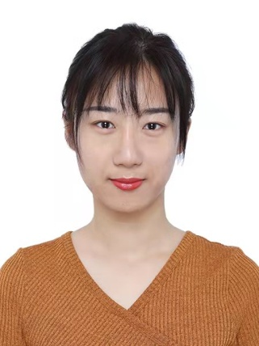
姓名：王思潼 英文名：Kaylee 毕业院校：四川外语学院 专业：英语翻译
证书：专业八级

Slide 3
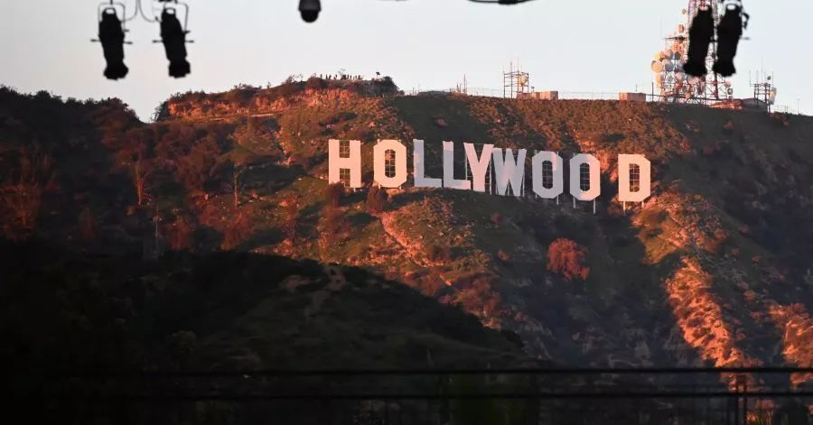

Slide 4
学习目标
语言
英语
初中英语

Slide 5
什么是英语？
ABC
words
sentences

Slide 6
句子怎么组成的
Run .
Leave.
Study.
He runs.
She left.
They’re studying.
He runs around the park.
He runs every morning.
He runs around the park every morning.
He runs slowly.

Slide 7
十大词性（语法基础概念）
1.名词 n.
2.冠词 art.
10.感叹词 interj.
3.代词 pro.
4.介词 pre.
5.连词 conj.
6.形容词 adj.
7.副词 adv.
8.动词 v.
9数词 num.

Slide 8
九大成分（语法基础概念）
主语
谓语
宾语
定语
状语
补足语
表语
双宾
同位语
He runs.
He runs.
I like you.
I am a beautiful girl.
He runs every morning.
Mother made him stay at home.
I am a boy.
Give me the book.
We chinese are proud of our history.

Slide 9
两种句型 （语法基础概念）
1.简单句
陈述句 I am a student.
倒装句 So did he. Here you are.
2.复合句
宾语从句
定语从句
疑问句 Are you a student? What’s the time?
祈使句 Let’s go.
感叹句 what a nice day!
状语从句

Slide 10
时态（80%）
时间 状态 | 现在 | 过去 | 将来 | 过去将来
一般 | do/dose | did | will/shall do Be going to do | would/should do
进行 | am/is/are doing | was/were doing
完成 | have/has done | had done
完成进行

Slide 11
几种易混淆时态
一般现在时与现在进行时
一般过去时与过去进行时
现在完成时与一般过去时
现在完成时与过去完成时
一般过去时与过去完成时

Slide 12
动词变化规则
动词原形变为第三人称单数的规则does
动词原形变为现在分词的原则doing
动词原形变为动词过去分词的原则done
动词原形变为动词过去式的原则did

Slide 13
一般现在时
1.表示经常习惯性的动作（一般现在时常用的时间状语often. always. sometimes. usually. never. seldom. every day. on weekends. once a week）
eg. They often take a walk after supper.
They go to the Palace Musemu once a year.
真题：Bill likes reading. He_______ picture books with his dad every evening.
A. read B. reads C.is reading D.has read

Slide 14
一般现在时
2.表示主语现在的特征或状态（能力、性格等）
eg.Tom has a good sense of humor.
I like maths very much.

Slide 15
一般现在时
3. 永恒真理、既定事实、俗语等（无时间限制）
例题. Yesterday the teacher told us the earth_______the sun.
A.goes around B.went around C.is going around D.would go around

Slide 16
一般现在时
4.一般现在时表将来
a.表十分确定会发生或按照表进行的事情(常可以这样用的仅限于少数表短暂意义的词如come.go.run.start.begin.return.leave.take place）
The train for Haikou leaves at 8:00 in the evening.
The final exam takes place next week. Please get prepared.
b.在时间和条件状语从句中用一般现在时表将来，主句一般用一般将来时（主将从现 ）
If it rains tomorrow, we will have to stay at home.
Please ring me up as soon as you arrive in Germany.

Slide 17
一般现在时（长久性，一惯性，事实性）
1.表示经常习惯性的动作
2.表示主语现在的特征或状态（能力、性格等）
3. 永恒真理、既定事实、俗语等（无时间限制)
4.一般现在时表将来
a.表十分确定会发生或按照表进行的事情
b.在时间和条件状语从句中用一般现在时表将来，主句一般 用一般将来时（主将从现 ）

Slide 18
现在进行时
1.现在正在时刻进行的动作或状态（常与now,at present,at this moment,look,watch,listen等瞬间提示词连用）
Where is Sue? -she is having a bath.
Look, the bus is coming.
Listen, the girl is singing a song.
真题. Tom, would you please take out the rubbish?
Just a minute, Mom. I _______ a phone call.
A.make B.makes C.am making

Slide 19
现在进行时
2.现阶段（说话前后一段时间内）一直在进行的活动，但此时此刻不一定在进行
Mr. Green is writing another novel.
We are preparing for the final exam these days.

Slide 20
现在进行时
2.现阶段（说话前后一段时间内）一直在进行的活动，但此时此刻不一定在进行（提示词these days/weeks/months…at the moment）
What are you doing these days?
I’m learning swimming.
Ah, I’m learning Italin.

Slide 21
现在进行时
3.表示即将要发生的动作（常与come, go,arrive,leave, start begin,return,run等非延续性动词连用）
I’m leaving tomorrow.
We are flying to Shanghai next Monday.

Slide 22
现在进行时
4.不断重复的动作（含情绪）常与always, forever等词连用
You are always changing your mind.
I’m always meeting Tom in that park.

Slide 23
现在进行时（暂时性，一时性，情感性）
1.现在正在进行的动作或状态
2.现阶段（说话前后一段时间内）一直在进行的活动，但此时此刻不一定在进行
3.表示即将要发生的动作
4.不断重复的动作（含情绪）

Slide 24
时态辨析
现在进行时（暂时性，一时性，情感性）
一般现在时（长久性，一惯性，事实性）
Boats pass under the bridge.（长久性）
The boat is passing under the bridge.（暂时性）
She always works late.（事实性）
She is always working late.（情感性）

Slide 25
时态辨析
现在进行时（暂时性，一时性，情感性）
一般现在时（长久性，一惯性，事实性）
He is friendly.（一惯性）
He is being friendly.（一时性）
You are stupid.
You are being stupid.

Slide 26
时态辨析
现在进行时（暂时性，一时性，情感性）
一般现在时（长久性，一惯性，事实性）
Do you speak Chinese?
Are you speaking Chinese?
Do you listen to the radio?
Are you listening to the radio?

Slide 27
练习
The house belongs to Mr. Smith, but he is not living here any more.
The house belongs to Mr. Smith, but he doesn’t live here any more.
The latest mobie phone is made in china.
The latest mobie phone is making in china.

Slide 28
练习
Listen! The baby cries in the next room. ( )
Look! The twins are wearing new sweater. ()
Who is speaking English best in your class? ()
Can you hear those people? What do they talk about? ()
Look! That man tris to open the door of your car.()
I must go now. It gets late. ()

Slide 29
练习
-How noisy it is outside!
-Oh, I forget to tell you. My neighbours______(decorate) their house.
The policeman will go back to the police station as soon as he _____(catch) that thief.

Slide 30
练习
The silk scarf is pretty and ______(match) her blue coat very well.
-Oh dear! My mobile phone has turned into a brick. It’s not working at all.
-Well, it ____(happe). Take off the battery and put it back on later.
It’s nine o’clock in the morning. Zhu Hui’s parents ______(make) zongzi at home.

Slide 31
练习
A: When _____usually ____________(finish)?
B: At 6:00 p.m.
A: Why __________now?(leave)
B: I have a dentist's appointment.(预约）

Slide 32
练习
My sister _____ the piano very well, but she hasn’t had time to play recently.
Bill likes reading. He _____picture books with his dad every evening.

Slide 33
练习
A: What ________(do) now?
B: Looking at a new car.
A: How much _________(cost)?
B: 10,000 dollars.

